Slide 1
The Use & Abuse of Economics in the Recent Nobel Laureates:
The Case of Property Rights and Development for 2024 & The Case of Innovation, Disruption and Economic Growth for 2025
Indian Institute of Science (IISc)
7th November 2025
Dr. Ravi Bhandari
Visiting Chair, Planning Commission, Karnataka | Professor of Eminence, MSRUAS | Senior Fulbright Scholar www.ravibhandari.com

Slide 2

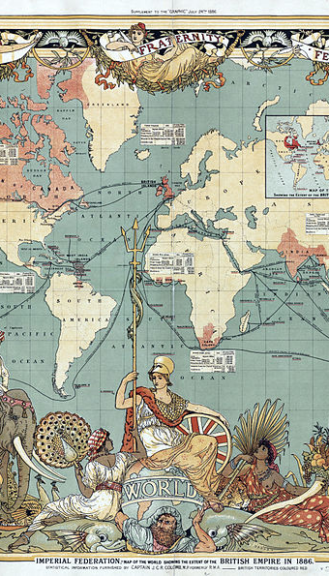

Recent Nobels, Old Anglo-Centric Myths: Why Nations Fail?
Critique of New Institutional Economics (NIE)

Slide 3
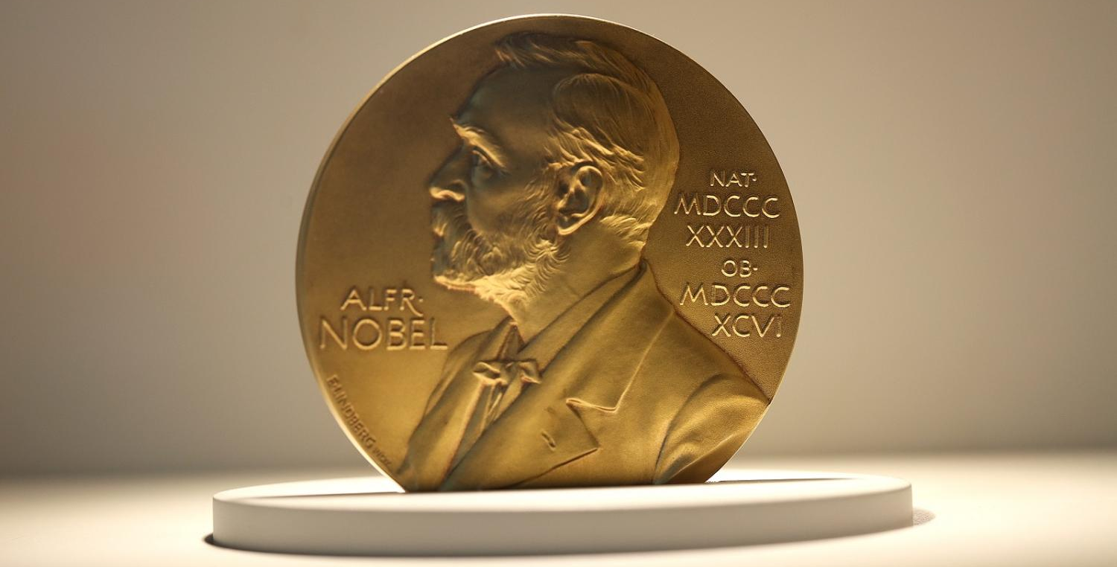
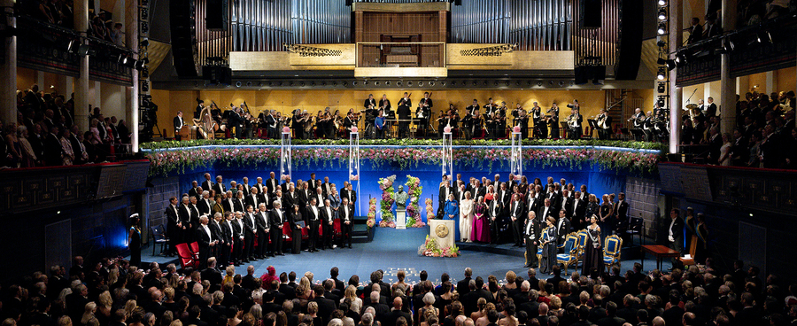
The “So-Called Nobel”
Another Nobel,
Same Claim
AJR awarded for “good institutions = growth, equity, democracy”
Builds on Douglass North’s legacy
Anglo-European property rights upheld as universal model
Notes:
New institutional economics (NIE) has received another so-called Nobel prize, ostensibly for again claiming that good institutions and democratic governance ensure growth, development, equity and democracy.
Daron Acemoglu, Simon Johnson, and James Robinson (AJR) are well known for their influential cliometric work. AJR have elaborated earlier laureate Douglass North’s claim that Western style individual private property rights have been crucial to growth and development.
But the trio ignore even North’s more nuanced later arguments. For AJR, ‘good institutions’ were transplanted by Anglophone European (‘Anglo’) settler colonialism. While perhaps methodologically novel, their approach to economic history is reductionist, skewed and misleading. Moreover, it is old colonial ideology dressed up in a new label of new institutional economics.

Slide 4
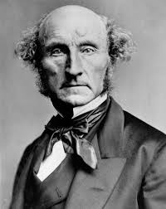

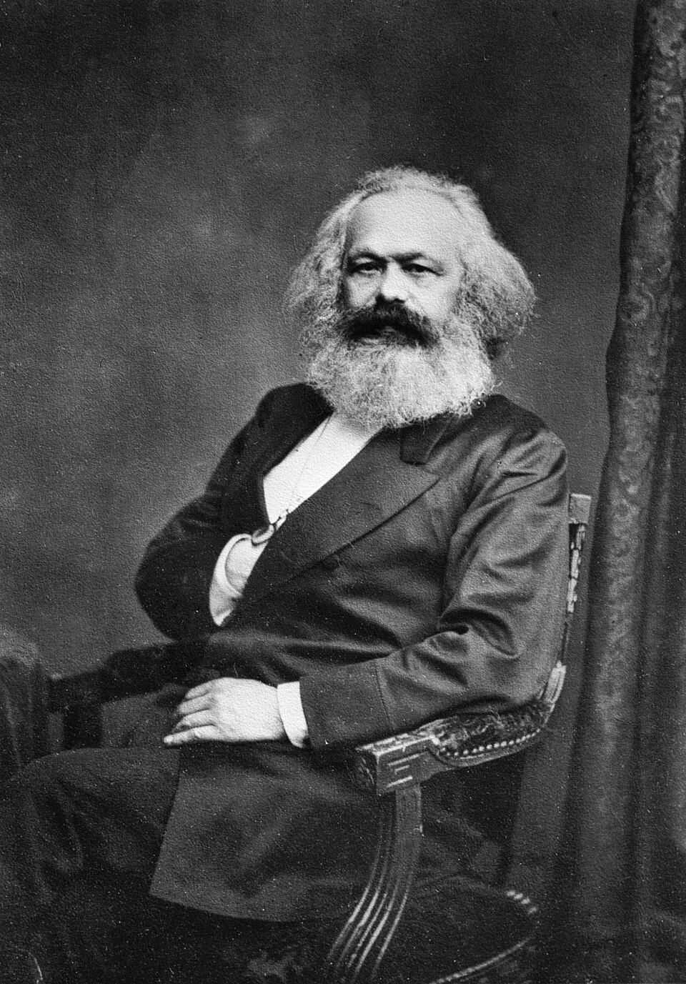
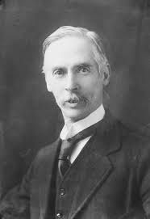
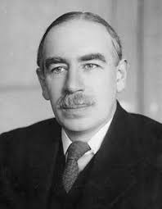
Ignored Voices
Varied traditions of property rights erased
Erasure of alternative critiques (Mill, Naoroji, Marx, Hobson, Keynes).
Notes:
NIE caricatures
AJR fetishises property rights as crucial for economic inclusion, growth and democracy. They ignore and even negate the very different economic analyses of John Stuart Mill, Dadabhai Naoroji, Karl Marx, John Hobson and John Maynard Keynes, among other liberals.

Slide 5
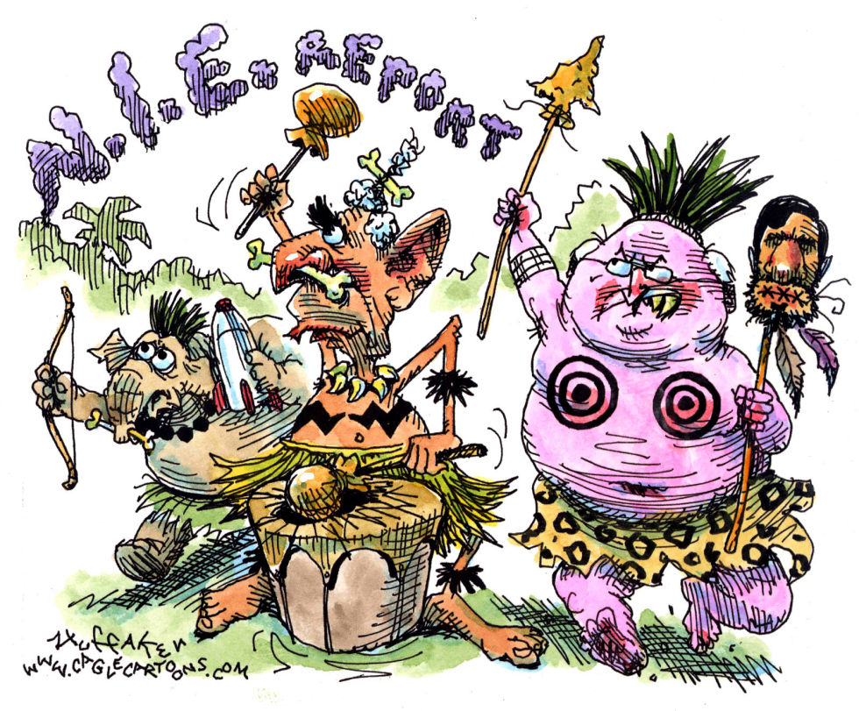
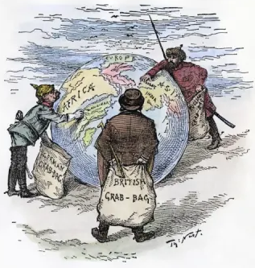
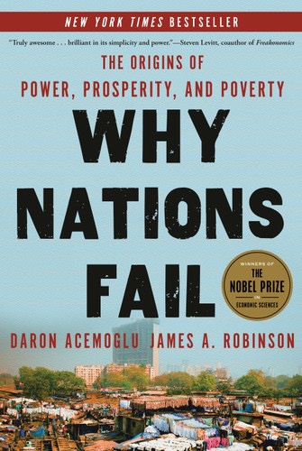
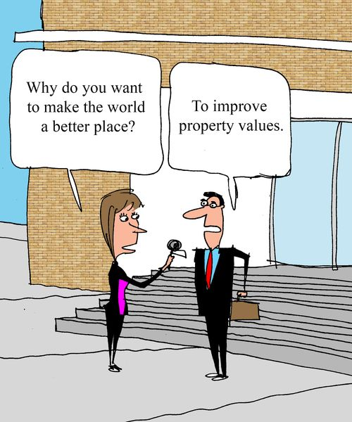
Core Thesis of AJR
Property Rights Fetish
Western-style private property = inclusion
Good vs. extractive institutions
Anglo settler colonialism as model of “success”
Notes:
Historians and anthropologists are very aware of various claims and rights to economic assets, such as cultivable land, e.g., usufruct. Even property rights are far more varied and complex throughout history, time, and space.
The legal creation of ‘intellectual property rights’ confers monopoly rights by denying other claims. However, NIE’s Anglo-American notion of property rights shockingly ignores the history of ideas, sociology of knowledge, and economic history.
More subtle understandings of property, imperialism and globalisation in history are entirely conflated. AJR barely differentiate among various types of capital accumulation via trade, credit, resource extraction and various modes of production, including slavery, serfdom, peonage, indenture and wage labour. Primitive accumulation is not even considered nor any of the overwhelming critical literature of the past 75 years.
John Locke, Wikipedia’s ‘father of liberalism’, also drafted the constitutions of the two Carolinas, both American slave states. AJR’s treatment of culture, creed and ethnicity is reminiscent of Samuel Huntington’s contrived clashing civilisations. Most sociologists and anthropologists would cringe that this fully debunked idea has returned to prominence.
Colonial and postcolonial subjects remain passive, incapable of making their own histories. Postcolonial states are treated similarly and regarded as incapable of successfully deploying investment, technology, industrial and developmental policies.
Intellectual giants like Thorstein Veblen, Karl Polanyi, Laureate Elenor Ostrom among famous others, have long debated institutions in political economy. But instead of advancing institutional economics, AJR pursue NIE’s methodological opportunism and simplifications set it back to reproducing an old colonial ideology, blame the victim on the victim. The Global South is yet to be advanced Because it is always lacking in something, or inadequate, or deficient in some western institution.

Slide 6
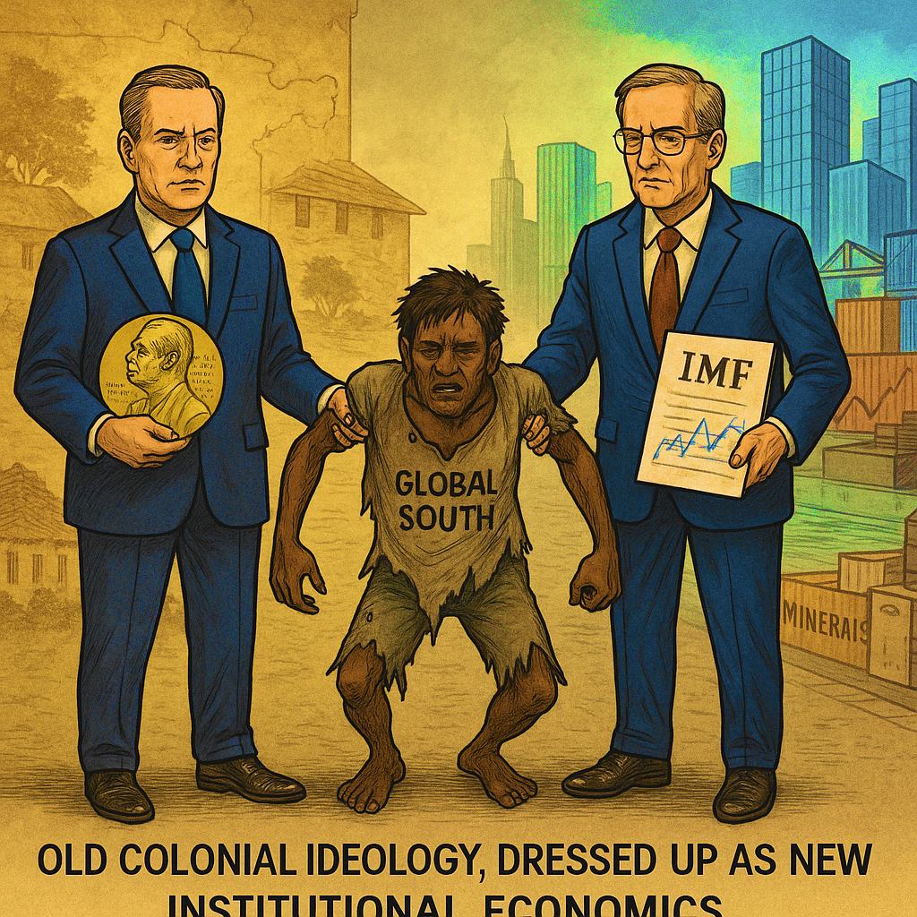
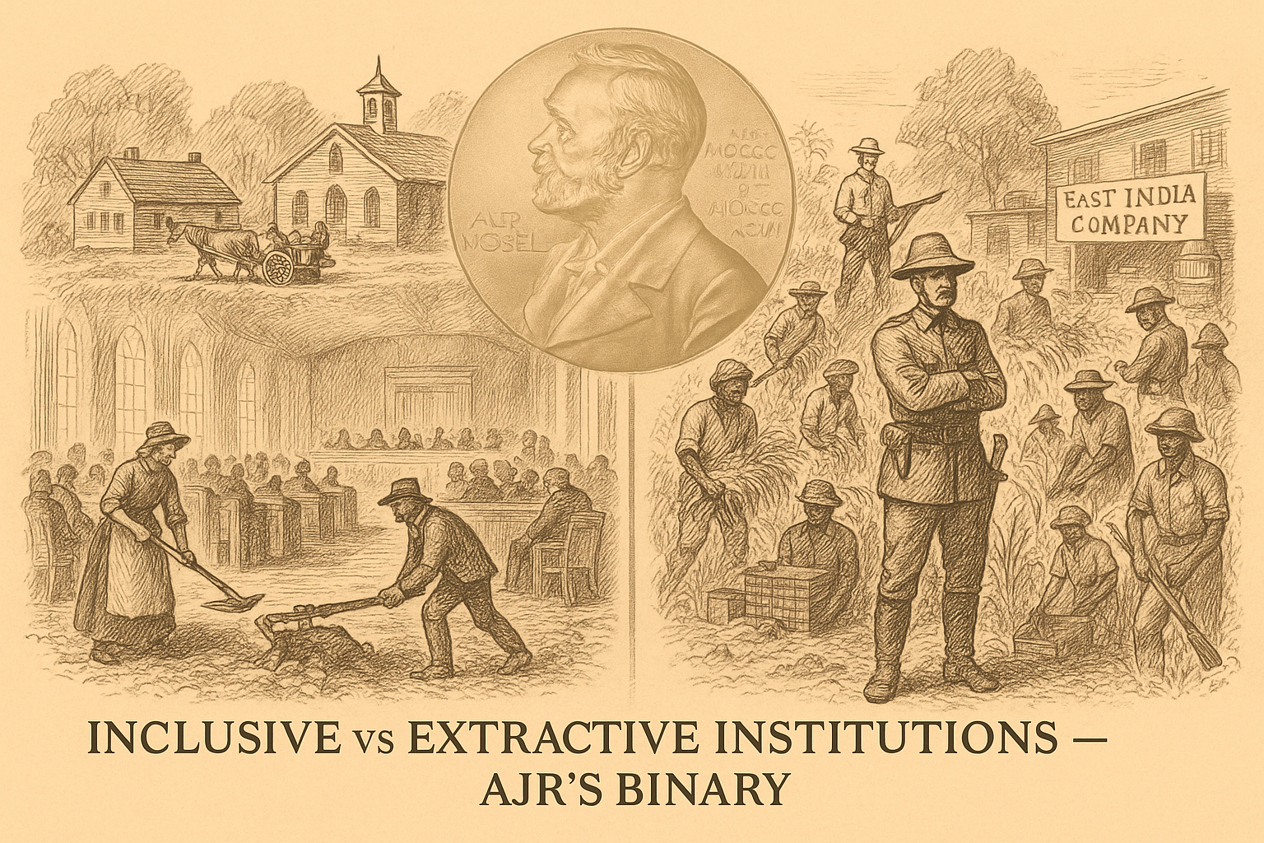
Property Rights Are Not Universal
Complex, Contested, Conditional
Inclusive vs. Extractive Institutions, AJR’s binary
Old colonial ideology dressed up as new institutional economics
Notes:
Another NIE Nobel
For AJR, property rights generated and distributed wealth in Anglo-settler colonies, including the US and Britain’s dominions like Australia and Canada. Their advantage was allegedly due to ‘inclusive’ economic and political institutions due to Anglo property rights.
Variations in economic performance are attributed to successful transplantation and settler political domination of colonies. More land was available in the thinly populated temperate zone, especially after indigenous populations shrank due to genocide, ethnic cleansing and displacement.
These were far less densely populated for millennia due to poorer ‘carrying capacity’. Land abundance enabled widespread ownership, deemed necessary for economic and political inclusion. Thus, Anglo-settler colonies ‘succeeded’ in instituting such property rights in land-abundant temperate environments.
Such colonial settlement was far less feasible in the tropics, which had long supported much denser indigenous populations. Tropical disease also deterred new settlers from temperate areas. Thus, settler life expectancy became both cause and effect of institutional transplantation. Being both an independent and dependent variable would not pass even any UG econometrics course!
The difference between the ‘good institutions’ of the ‘West’ – including Anglo-settler colonies – and the ‘bad institutions’ of the ‘Rest’ is central to AJR’s analysis. White settlers’ lower life expectancy and higher morbidity in the tropics are then blamed on the inability to establish good institutions in the tropics where “extractive” institutions are both persistent and pervasive.

Slide 7
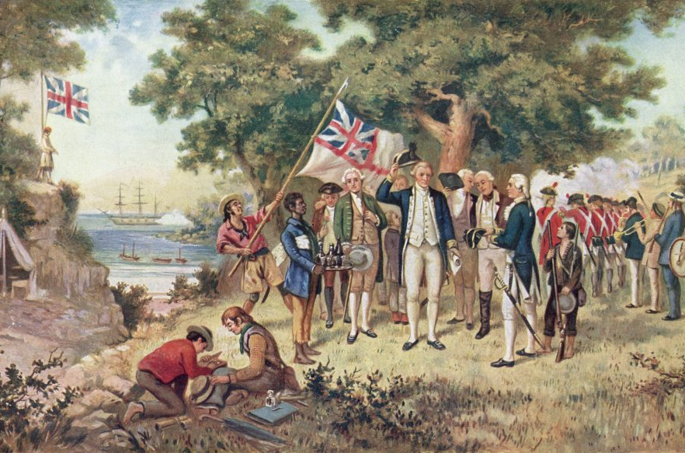
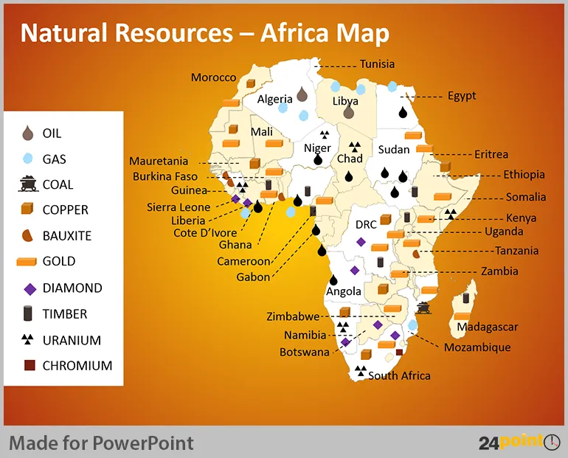
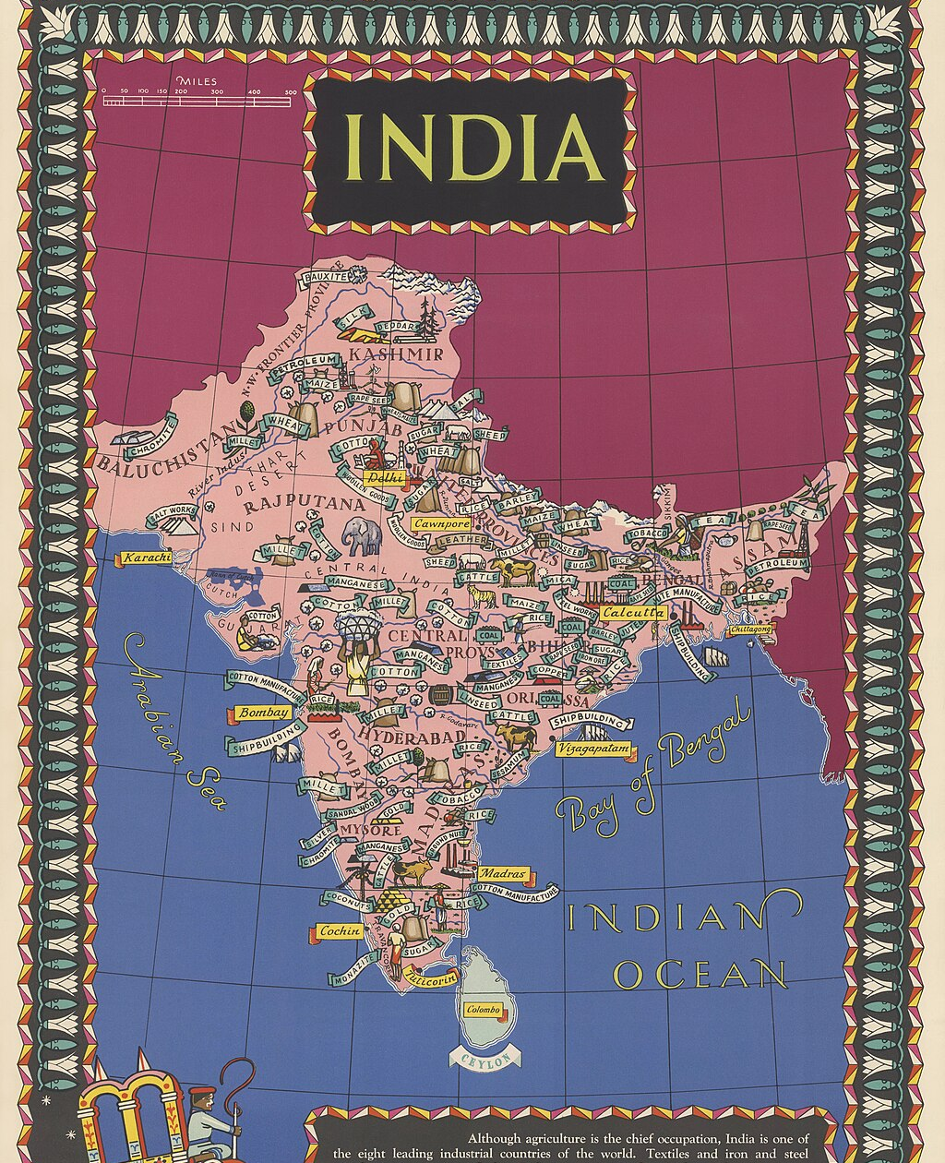
Anglo Settler Privilege vs. Good Institutions
British imperial preference, trade deals, investments
Genocide + land abundance ≠ superior institutions
Notes:
Anglo-settler privilege
However, correct interpretation of statistical findings is crucial. I offer a radically different interpretation of AJR’s econometric analysis.
The greater success of Anglo settlers could also be due to colonial ethnic bias in their favour rather than better institutions. Blood is thicker than water. Unsurprisingly, imperial racist Winston Churchill’s History of the English-Speaking Peoples celebrates such Anglophone Europeans.
AJR’s evidence, criticised as misleading on other counts, does not necessarily support the idea that institutional quality (equated with property rights enforcement) really matters for growth, development and equality even though they claim it.
I argue instead that international economic circumstances favouring Anglos have shaped growth and development. British Imperial Preference favoured such settlers over tropical colonies subjected to extractivist exploitation. Settler colonies also received the vast majority of British investments abroad, highly favorable trade agreements, etc.
For me, enforcing Anglo-American private property rights has been neither necessary nor sufficient to sustain economic growth. For instance, East Asian economies have pragmatically used alternative institutional arrangements to incentivise catching up.
Furthermore, “the authors’ inverted approach to concepts” has confused “the property rights-entrenching economies that they favor as ‘inclusive’, by way of contrast to resource-centered ‘extractive’ economies.” This is precisely what dependency theory as said all along. One one side of the coin you have inclusive institutions where Western settlers dominate, (temperate zones) and on the other side, extractive colonial type economies that finance Western democracy itself.

Slide 8

Property vs. Popular Rights False symmetry in AJR
False symmetry in AJR
Rawlsian “Property-Owning Democracy”
Plutocratic oligarchy
Notes:
Property vs popular rights
AJR’s claim that property rights ensure an ‘inclusive’ economy is also far from self-evident. A Rawlsian property-owning democracy with widespread ownership contrasts sharply with a plutocratic oligarchy. There is a false sense of symmetry that devastates their overall argument.
Nor does AJR persuasively explain how property rights ensured political inclusion. Protected by the law, colonial settlers often violently defended their acquired land against ‘hostile’ indigenes, denying indigenous land rights and claiming their property.
‘Inclusive’ political concessions in the British Empire were mainly limited to the settler-colonial dominions. In other colonies, self-governance and popular franchises were only grudgingly conceded under pressure.
Prior exclusion of indigenous rights and claims enabled such inclusion, especially when surviving ‘natives’ were no longer deemed threatening. Traditional autochthonous rights were circumscribed, if not eliminated, by settler colonists.
Entrenching property rights has also consolidated injustice and inefficiency. Many such rights proponents oppose democracy and other inclusive and participatory political institutions that have often helped mitigate conflicts.
The Nobel committee is supporting NIE’s legitimisation of property/wealth inequality and unequal development, amounting to apartheid on a world scale. Rewarding AJR also seeks to re-legitimise the current free trade globalization and neoliberal project at a time when it is being rejected more widely than ever before.

Slide 9
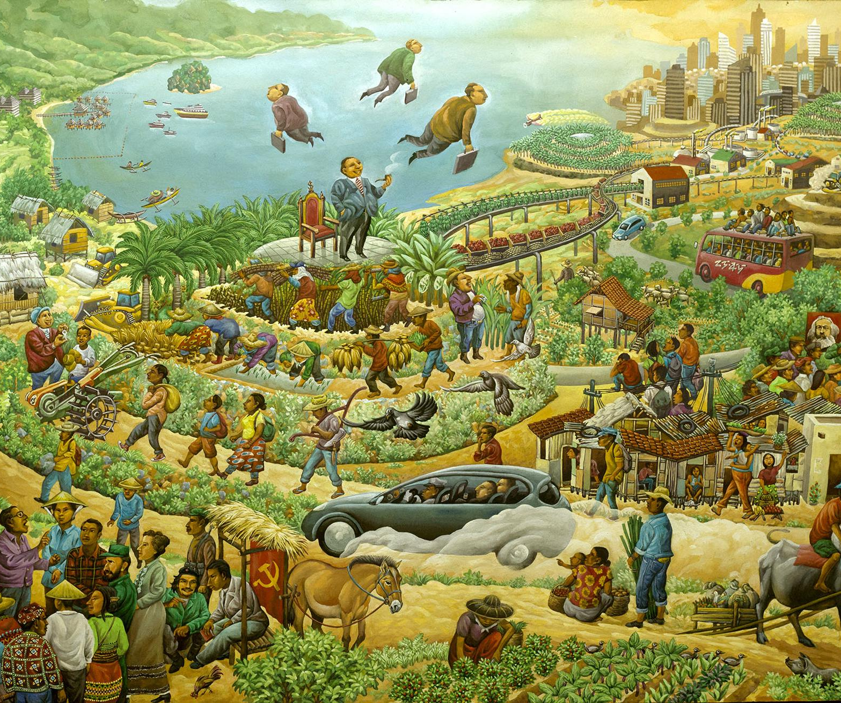

Global Unregulated Capitalism, Incapable of resolving the Agrarian Question?
Notes:
Q&A
Question: About trade and development, you argue that, "far from being resolved, the'agrarian question' lies, now more than ever, at the heart of the challenges
that humanity must face in the twentieth century." Why do you think that global unregulated capitalism, "by its very nature, is incapable of resolving it," and why do you believe that it can offer only the prospect of a planet of slums worldwide?
Answer:
AJR ignore the agrarian question and history altogether. Accumulation by dispossession, which characterizes historical capitalism,
crystallized around the London-Amsterdam-Paris triangle in the early nineteenth century, applied to not only the peoples of the Americas but also the European peasants. The model is that of the enclosures in Great Britain, in which the British and Irish peasants were the first in Europe to be subjected to private appropriation of land, which was later generalized the European continent.

Slide 10


Beyond Anglo-Centric Myths
European Safety Valves and Security Apparatus Provided by the System of Migration to the Americas
Processes of Migration Allowed Europe to Build a New Europe Elsewhere
This Western Development Model Requires Four More
Untouched Continents Regardless of Property Rights or Institutions
Otherwise a Continuing Planet of Slums
Notes:
This historical model would have had explosive consequences had it not been accompanied by an enormous "security apparatus" and "safety valves" provided by the system of migration to the Americas. The processes of migration allowed Europe to build a new Europe elsewhere, which was as important as, if not more important than, the original continent in terms of population. But, if we consider the other continents -- Asia, Africa, and Latin America -- where today seventy-five percent of the world population (one half of whom are peasants) live, we realize that this system is both unacceptable and ineffective. As demonstrated by the recent birth of a planet of slums, peasants expelled from their land cannot be "absorbed" by the mechanisms of modern industrialization and they cannot en masse resort to migration. If the agrarian question were to be solved according to the current economic model rooted in free trade economic theory and even assuming the “right institutions” ala AJR, then at least four more Americas would have to be given to Asia, Africa, and Latin America in order to develop! Moreover, how can every country simultaneously export their way out of poverty and underdevelopment? Somebody has to import and the US can no longer be the buyer of last resort. Both solutions are impossible, but play an essential ideological role in not only reproducing the myth of free trade but also the related myth that it is just a matter if getting “institutions right” beyond getting “prices right.”

Slide 11

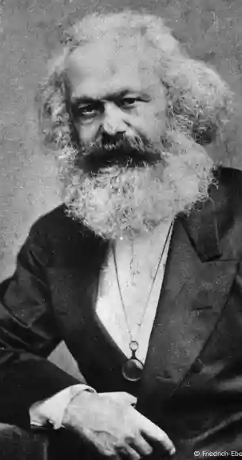
The Use and Abuse of Joseph Schumpeter and Karl Marx
Mass Destruction is not a Mathematical Inevitability nor Necessary Negative Externality For Systemic Health
Creative Destruction as Capitalist Pathology
Schumpeter and The Nobelist: Erasing Class and Inequality, Cheerleading the System
Joel Mokyr’s Culturalist Dodge
Aghion and Howitt’s Mathematical Fetish
Reclaiming the Crisis & Real Economics
Notes:
The 2025 laureates didn’t just study creative destruction; they completed a century-long project to drain Marx’s explosive critique of its revolutionary content, repackaging systemic violence of capitalism’s dynamism as a mathematical inevitability.
The laureates’ models are the ideological pinnacle of this neutering process: they have transformed the lived reality of class violence of the majority of humanity into a right hand side variable in a growth equation, where mass human suffering is a regrettable but simply a necessary negative externality for systemic health.
The rich have always needed compelling stories to explain away the wreckage global capitalism creates. This year’s Nobel Prize in Economics, awarded to Joel Mokyr, Philippe Aghion, and Peter Howitt for their work on “creative destruction,” offers its latest, most sophisticated fable. For that achievement credit is deserved. The parable of the rotary telephone evolving into the smartphone today is their Genesis: a clean, logical story where progress demands a little mess, and the outcome always justifies the means.
This is not just an academic debate; it is a battle over how we perceive the violence of globalization today that has left 5 billion people in the dust. The intellectual history of “creative destruction” is the history of a Marxist cannonball being disarmed, polished, and mounted on the mantlepiece of textbook economics as a harmless decorative object. The 2025 laureates are, in fact, the culmination of this project, not its critics. They have developed an “algebra of oppression” using mathematical deductions to prove that the system’s brutality is not just merely efficient, but logically necessary. Wow!
Marx: Creative Destruction as Capitalist Pathology
To understand the scale of this ideological theft, we must return to the raw, un-sanitized power of Karl Marx’s original analysis on this topic that even Schumpeter paid great homage to. For Marx, what we now call “creative destruction” was not a feature of a healthy economy, but the primary symptom of a profoundly sick and cruel one. It was the “law of motion of capital” in its most violent and self-contradictory form.
Marx’s genius was to identify this not as an external shock, but as an internal, cyclical imperative of the system itself. Schumpeter agreed with Marx that capitalism is dynamically changing from within and his magnum opus Kapital (1868) detailed how capital, in its drive for self-expansion, must constantly revolutionize the means of production to make profits But this very success leads to overaccumulation and a falling rate of profit as competition breeds monopolies. He was right. The system’s only way out? A crisis.
Periodically, capitalism must destroy its own foundations—’a great portion of capital’—through crises and the ‘enforced destruction of productive forces’ to restore profitability. The creation is for the very few 1% but the destruction is for the 99%.
This is not a metaphor. It is a description of a system seizing up. Marx wrote in the ‘Grundrisse’ of “explosions, cataclysms, crises, [the] annihilation of a great portion of capital.” This “annihilation” is the devaluation of capital—factories close, machinery rusts, companies go bankrupt, and millions of workers are thrown into the streets on any given day. This devaluation is the “destruction” that clears the ground, allowing the remaining capital to profitably reinvest and begin the cycle anew. The “creation” is the resurrection of profitability on the buried graves of the previous cycle’s investments and livelihoods. The devastating hurricane in Jamaica destroyed billions of dollars of property but economists are glorifying the creative part of rebuilding with a high growth rate!
For Marx and not Schumpeter this was a “class phenomenon”. The capitalist class, as a whole, orchestrates this process, and the average laboring majority overwhelmingly bears its cost. The violence is not accidental; it is fundamental to how the dynamics of capitalism operates.
Schumpeter and the Nobelists: Erasing Class, Celebrating the System
Joseph Schumpeter took Marx’s crisis theory and performed a critical operation: he removed the “class struggle”. He rebranded the capitalist as a heroic “Entrepreneur” and systemic crisis as a healthy “gale of creative destruction.” The focus shifted from the system’s internal contradictions to the psychological drive of heroic individual innovators. The “death sentence for the old agriculture” was no longer a tragedy but a testament to progress as history was seen as a steady march to progress.
The 2025 Nobel laureates have taken Schumpeter’s depoliticized framework and rendered it in the most politically sterile language available: mathematics.
Joel Mokyr’s Culturalist Dodge
Mokyr’s historical work, which won half the prize, shifts the locus of analysis from political economy to “culture”. By arguing that “openness to change” is the key to growth, he implicitly blames societies and workers for failing to adapt to the disruptions capital imposes. The problem is no longer the power of capital to direct change for its own benefit, but the cultural backwardness of those who resist their own obsolescence. It’s a theory of ideological preparation for perpetual disruption.
Aghion and Howitt’ Mathematical Fetishism
This is the core of the ideological alibi. Aghion and Howitt built mathematical models where creative destruction is the engine of macroeconomic growth. Their great “achievement” was to deductively prove that what is “massively upsetting” at the micro-level (for a worker, a community) is the very foundation of stability at the macro-level (for the system as a whole).
This is a profound epistemological sleight of hand. By adopting the “view from nowhere” of macroeconomic aggregates, they make “specific human suffering caused by regressive technological change magically disappear into a positive variable”. A vice becomes a virtue. Unemployment is not a personal catastrophe; it is a simple anf necessary friction coefficient. The collapse of a town’s main employer is not a social disaster; it is an efficient reallocation of resources in the model’s algorithm.
Their deductions are not wrong in a strictly very narrow, formal sense; they are “politically obscene”. They provide a scientific-sounding rationale for why we must not interfere and government must not intervene. Sound familiar? To implement strong worker protections, robust unemployment benefits, or public ownership would be to “distort” the beautiful, self-optimizing machine. Their math serves a clear interest f exclusively for the 1%. It justifies passivity in the face of oppression by framing it as a logical necessity.
Reclaiming the Crisis
The journey of “creative destruction” from Marx to the Nobel podium is a masterclass in pure ideological co-optation. It demonstrates how the ultra rich 1% class neutralizes its most potent critiques by absorbing and redefining them, just as the promoters of AI have misused and abused the definition of “intelligence” as if humans do not exist. AI is an excellent example of creative destruction where human creativity, which defines human intelligence, is totally destroyed for corporate profit and millions if not billions of jobs destroyed with no future alternative possibilities to transition to. It is no surprise that the current AI bubble is capitalism’s biggest and whose burst will have catastrophic consequences for economies worldwide since it is the only new money around.
Marx gave us a political and economic theory of systemic crisis, rooted in how creative destruction is how capitalism struggles to survive with dire consequences for humanity.
Schumpeter gave us a sociological: theory of dynamic change, rooted in individual heroism of the entrepreneur.
The Nobel Laureates have given us a technocratic theory of efficient growth, rooted in mathematical inevitability.
The laureates’ models are a firewall against a true understanding of real world economics. They tell us the pain is not just for a purpose, but is a deductive, logical and natural conclusion. But mathematics cannot resolve a huge economic contradiction just as AI cannot make a decision or tell if a decision is right or wrong. The fundamental conflict identified by Marx—between the socialized nature of production and the private appropriation of its gains—remains, privatized gains and socialized losses on a world scale.
Our task is to reject this bloodless algebra and reclaim the economic heart of the current crisis. True progress isn’t found in a system that requires periodic destruction, but in building one where the fruits of creation are collectively owned and the very concept of “destruction” as an economic imperative is consigned to the history books where it belongs

Slide 12
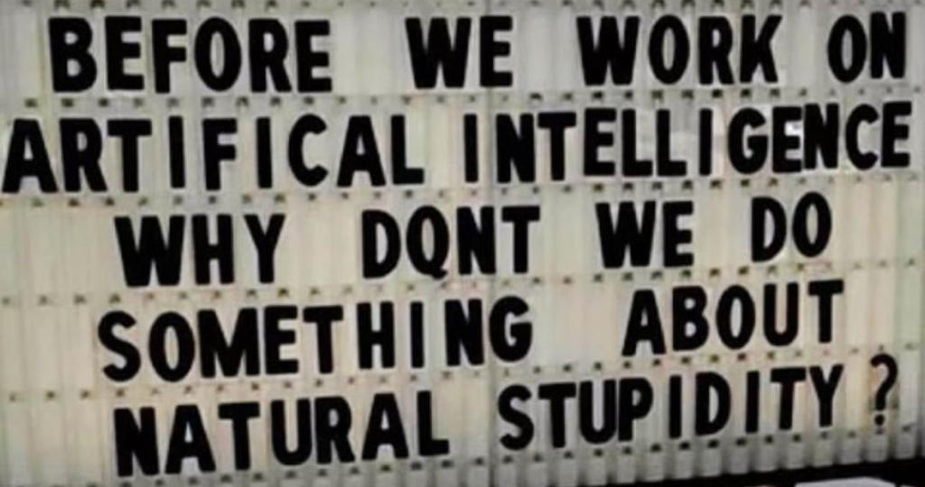

Slide 13
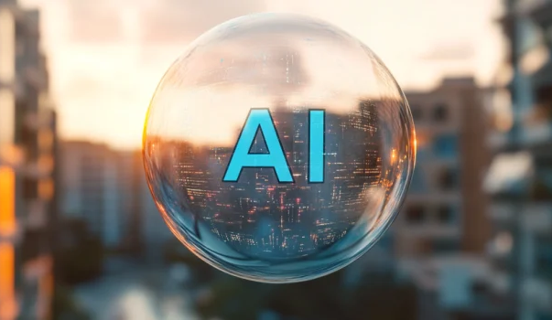
The AI Bubble Will Pop No Doubt: Don’t be Left Holding the Bag!
Technological Limits - AI models have hit diminishing returns; bigger doesn’t mean smarter.
Economic Collapse Risk - Generative AI companies like OpenAI lose billions; data centers are money pits.
No Real-World ROI - 95% of AI pilots fail to improve profit or productivity, while also slowing developers, increasing workloads, and raising costs.
Speculative Funding - AI’s growth is driven by oil-funded sovereign wealth and profits from the MAG 7
This is different from the Dot-Com Parallel
US investors vs sovereign oil money and MAG 7 internal profits
purely speculative in nature
bubble can grow indefinitely before it pops
Western investors are now a minority - a selloff will leave them shortchanged
Inevitable Burst - The longer the illusion holds, the greater the eventual financial damage.
Notes:
If you need any proof that the AI hype is getting a little out of control, just look at Musk. He has claimed that FSD will soon make car ownership obsolete, despite the fact that after a decade of development, it still drives like a myopic 12-year-old. He even recently claimed that Tesla’s AI robot Optimus, which so far has only shuffled around on completely flat surfaces like it has shat itself and been puppeteered like a ’90s Disney animatronic, will soon make up 80% of Tesla’s revenue. And, somehow, despite these brain-rotten, wildly unrealistic and idiotic claims, analysts and investors aren’t calling Musk a clown and are instead pumping money into his quaker schemes. So it is no wonder the idea that the AI bubble is about to burst has been floating around the media over the past week. However, some key elements of this conversation have been overlooked.
For one, we know that AI is a severely limited technology, yet the industry is pretending like it isn’t.
For example, we have known about the efficient compute frontier for years now. This boundary states that the maths behind AI is reaching a point of diminishing returns and that generative models are currently as good as they will get, even if the models are made exponentially large. We can already see this with ChatGPT-4 and 5, which, despite OpenAI significantly increasing the model size and training time, have only delivered very minor improvements.
Then there is the Floridi Conjecture, which again explains that the maths that powers AI means that AI systems can either have great scope but no certainty or a constrained scope and great certainty. Crucially, Floridi’s Conjecture states that an AI absolutely can’t have both a great scope and great certainty. This means that AI models, which are treated as general-purpose intelligent systems, like LLMs or Tesla’s FSD, can never be reliable, as their scope is far, far too large. But in more constrained applications, in which the system isn’t treated as intelligent, it can be made dependable and reliable.
This inability to be even remotely accurate in a broad application is reflected in real-world applications.
A recent MIT report (2024) found that 95% of AI pilots didn’t increase a company’s profit or productivity. For the 5% in which it did, the AI was relegated to back-room, highly constrained admin jobs, and even then, there were only marginal improvements.
A METR report found that AI coding tools actually slow developers down. The inaccuracy of these models means they repeatedly make very bizarre coding bugs that are highly arduous to find and correct. As such, it is quicker and cheaper to get a developer to code it themselves.
Research has even found that for 77% of workers, AI has increased their workload and not their productivity.
Then there is the issue of treating AI as intelligent, even in slightly constrained tasks. Take Amazon, which used AI to power its checkout-less stores before switching to remote workers, given that the AI was getting it wrong so frequently and costing them so much money that it was unsustainable. Even in very constrained tasks like this, AI’s constant errors are more costly than the savings they deliver.
The real-world data and our understanding of this technology have painted a very clear picture. AI is a severely limited technology, which cannot improve much past its current form and only has a positive impact in a few niche and mostly boring applications.
Contrast that to the claims of AI giants like OpenAI, which promises that AI superintelligence is just around the corner and that AI will disrupt the entire economy, as it will displace hundreds of millions of jobs. This is the promise that has lured hundreds of billions of investor dollars towards generative AI start-ups. But it could not be further from the truth.
This is a substantial issue, as generative AI companies are so far from profitability that it is painful.
Take OpenAI. Despite having by far the largest income of any AI company by a country mile, they are still losing a dramatic amount of money for every one of their $200-a-month plans. Their models are just too expensive to build and run. In fact, even if they built much more efficient models, like those from DeepSeek, they would likely still lose money at that price point. Naturally, analysts have found that OpenAI is set to post a loss of over $14 billion in 2026, which is a larger loss than many of the banks that folded in 2008. OpenAI’s own numbers suggest that by 2029, they will post losses in the hundreds of billions of dollars.
Even datacentres, the infrastructure behind AI, are wildly unprofitable. Praetorian Capital CIO Harris Kupperman recently revealed that the AI data centres being built today will suffer $40 billion of annual depreciation while generating somewhere between $15 and $20 billion of revenue. In other words, the infrastructure itself is a money pit. But there are far more additional costs at play, from energy and water to data acquisition and preparation and even AI testing. Kupperman found that if you take these costs into consideration, generative AIs need to increase their revenue by ten times just to break even.
That $200-a-month OpenAI plan? OpenAI needs to sell it for $2,000 a month to break even. That is backed up by a leaked memo from OpenAI about a year ago that suggested they were thinking of raising prices to that exact level.
So, generative AI isn’t going to get much better than it currently is, is only useful in a select few applications, and has no viable route to profitability. Does anyone fancy investing?
With Meta’s dramatic restructuring of their AI division and the monumental disappointment of ChatGPT-5, along with the revelation of insights like those above, the market is beginning to realise this and is slowly getting cold feet.
This is why talk of the AI bubble bursting has been everywhere.
Particularly because it bears a striking resemblance to the dot-com bubble of the ’90s. Web 1.0 and 2.0 kickstarted the internet revolution, and investors jumped on the opportunity. Any business that operated on the internet had huge amounts of venture capital poured into it, even if it was functionally useless and had no route to profitability. And over the course of just a few years, the value of internet companies soared far beyond reality, creating a bubble. The AI bubble is exactly the same.
Where it differs is where the money comes from.
In 2000, the US economy was at risk of overheating and suffering from rampant inflation, so interest rates were preventatively hiked, making debt expensive. It was mostly US investors who grew the dot-com bubble, and many of these investors used debt to invest in these unprofitable companies. So, they suddenly wanted to see a profit to service their debt, and when it became apparent that couldn’t happen, they sold. This widespread sell-off popped the bubble, crushing most of the internet companies and impacting the entire economy.
But you’ll notice we are also experiencing inflation and spiking interest rates. This AI bubble should have popped already. But then why hasn’t it yet?
I think it is partly because of the less tangible reality of AI than internet businesses. The attraction of AI is the corporate myth with billions in advertising of what it could eventually be. Meanwhile, internet businesses were valued based on the convenience for customers. It is harder to pop something that is purely speculative, so the bubble can grow larger.
But there is also the fact that the dot-com bubble grew with American money, whereas the AI bubble is funded by oil money. Most big AI companies, like OpenAI; most big venture capital firms, like Softbank; and most big tech companies, like Microsoft, are largely funded by the Saudi sovereign wealth fund, which invests the country’s oil profits to the tune of hundreds of billions of dollars. Then, these companies invest in each other’s AI pushes as part of their own boardroom nepotism which raises their value - for example, Microsoft and Softbank have both invested in OpenAI. This means that interest rates don’t affect the flow of money into AI the same way they did with the dot-com bubble.
As a side note, this is why AI’s horrific energy usage isn’t a bug but a feature for the industry. The investors are using it to scupper net zero and keep the world hooked on oil by dramatically increasing our energy needs.
This means the AI bubble will likely grow larger before it pops.
Indeed, some analysts have found that if AI demand stays the same, the pop can be staved off. Likewise, many Western investors know that a huge sell-off will leave them short-changed, particularly as they are not the majority of investors, like they were in the dot-com bubble.
However, there is also a significant chance that the glitz of the AI hype train will wear off, demand will begin to decline, and its associated value will dwindle as more and more AI pilots fail, new research finds that AI tools are actually counterproductive, and prices for AI inevitably start to rise. Even if Saudi oil money continues to flood the space, this process will be enough to trigger a sell-off, popping the bubble.
Really, the question isn’t if the bubble will pop, but when.
And the issue is, the longer it takes to pop, the larger the bubble will become, and the more our financial institutions, pensions and economy will become intertwined with it, making it even more damaging when it does eventually pop.

Slide 14

95% Of Gen-AI Projects Are Failing - And Markets Can Smell The Fear
95% of Gen-AI projects are failing - MIT finds only 5% generate real revenue growth.
Massive investment surge: US $109 B in 2025 AI funding; valuations now mirror dot-com levels.
Speculation vs. substance: Real-world productivity gains remain limited even as markets soar.
Global risk: If the AI bubble bursts, it could slow US GDP and ripple through global economies.
Notes:
The United States remains the epicentre of AI innovation and investment, thus making its economy highly sensitive to any and all shifts in AI market dynamics. AI investments accounted for nearly 92% of America's GDP growth in the first half of 2025. In the same time, AI-related capital expenditures contributed a whopping 1.1% to GDP growth, outpacing the US consumer as an engine of expansion.
This has led experts to warn that a contraction in AI spending could give the US economy, already burdened by rising debt and tariffs, the tip it needs to go into recession.
The bursting of the AI bubble could trigger a domino effect, which would lead to a rapid downshift in AI stock valuations, which, in turn, would erode household wealth and take a huge toll on investor confidence in the market while pulling down overall market indices. It would also lead to companies slashing AI budgets and broader capital expenditures, which would, in turn, slow innovation and dampen productivity growth.
A sudden slowdown in AI-related sectors would also most likely trigger layoffs and downward pressure on wages, particularly in technology-driven regions where employment and income growth have become heavily dependent on the AI boom.
Globally, an AI bubble burst could lead to a weakening of the global financial sentiment and slow down international trade. Countries heavily reliant on technology exports and AI-driven service industries would face reduced external demand, while emerging markets could possibly experience capital outflows as investors shift funds toward safer assets, leading to an amplification of the exchange and liquidity pressure. The IMF and other major financial institutions have come out cautioning that current equity valuations are precariously stretched. The world economy at this very moment faces a "triple risk" scenario emanating from the United States, involving tariffs, the AI bubble, and mounting debt burdens, all of which threaten medium-term growth prospects.
Geopolitical Dynamics
Geopolitical competition, especially between the United States and China, have heavily influenced AI investment strategies and bubble risks. China's government-led approach via state-sponsored enterprises contrasts with the US's mix of private sector innovation and selective federal public funding.
This dynamic increasingly mirrors the Cold War-era's ideological competition between states across the Pacific - only this time, the battlefield is technological, fought with chips rather than military might with Dvina's and Titan's.
Ramifications for India's Economy
India stands at a critical juncture in the AI revolution. While the United States and other developed economies lead AI investment and development, India's burgeoning tech sector positions India as a major future beneficiary of AI-accelerated growth.
Recent estimates suggest that the generative AI revolution in India could positively impact over 38 million employees by 2030, contributing to a productivity boost of approximately 2.6% in the organised sector alone, with an additional possible 2.82% productivity increase that could be achieved by extending GenAI's adoption to the unorganised sector.
AI-driven changes are anticipated to be especially significant in service industries such as information technology, information technology-enabled services, finance, healthcare, and retail, fundamentally altering how these sectors handle customer acquisition and operations.
Despite this promise, India's AI journey will be shadowed by vulnerabilities that are linked to the global AI investment bubble. The volatility and speculative excess typical of bubbles of this nature, scale and magnitude may deter the capital that Indian firms increasingly require, hampering sustained investment. Moreover, the concentration of AI capital in developed markets risks widening inequalities unless balanced by robust and pragmatic domestic policy.
As Amara's Law states, "We tend to overestimate the effect of a technology in the short run and underestimate the effect in the long run." Although the bubble may burst and cause short-term disruption, AI's long-term impact on productivity and growth will likely be profound. Therefore, careful governance and prudent investment are essential to navigate this ever-evolving landscape.

